Slide 1
Chapter 6: APPLICATIONS OF THE INTEGRAL
Contents:
6.1 Area Between Two Curves
6.2 Setting Up Integrals: Volume, Density, Average Value
6.3 Volumes of Revolution: Disks and Washers
6.4 Volumes of Revolution: Cylindrical Shells
6.5 Work and Energy

Slide 2
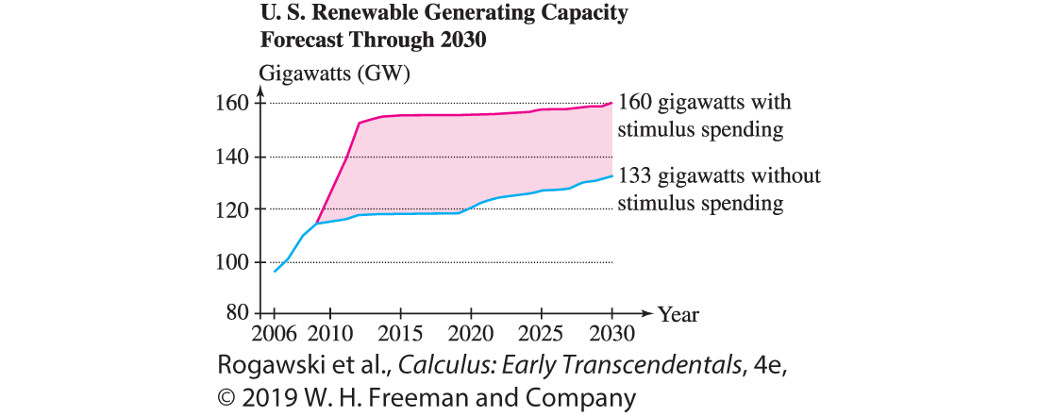
6.1 Area Between Two Curves (1 of 15)
Sometimes we are interested in the area between two curves. Figure 1 shows projected electric power generation in the United States through renewable resources (wind, solar, biofuels, etc.) under two scenarios: with and without government stimulus spending. The area of the shaded region between the two graphs represents the additional energy projected to result from stimulus spending. How can we compute such an area?

Slide 3
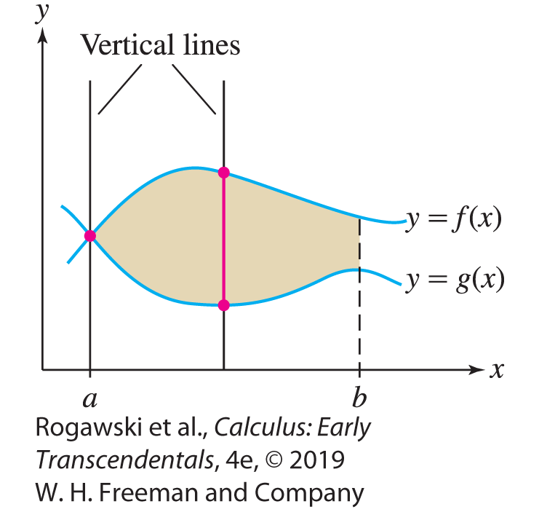
6.1 Area Between Two Curves (2 of 15)
Now suppose that we are given two functions y = f (x) and y = g(x) such that f (x ) ≥ g(x ) for all x in an interval [a, b]. We call such a region vertically simple since any vertical line that intersects the region does so in a single vertical line segment or point with its lower endpoint on the graph of y = g(x) and upper endpoint on the graph of y = f (x), as appears, for example, in Figure 2.

Slide 4
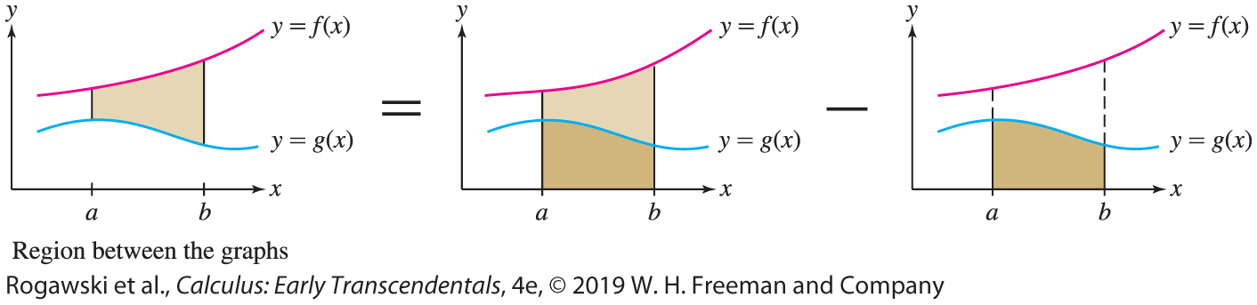

6.1 Area Between Two Curves (3 of 15)
Then the graph of y = f (x) lies above the graph of y = g(x), and the area between the graphs is equal to the area under the top function minus the area under the bottom function:
$$\text{a}\text{re}\text{a} \text{betwee}\text{n} \text{th}\text{e} \text{graph}\text{s} \text{=}\int_{a}^{b}{f(x)}dx−\int_{a}^{b}{g\left(x\right)}dx=\int_{a}^{b}{(f\left(x\right)−g\left(x\right))}dx$$
We see that the region between the graphs is obtained by removing the region under y = g(x) from the region under y = f (x).

Slide 5
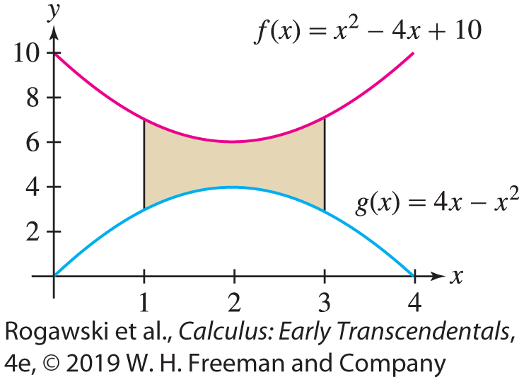

6.1 Area Between Two Curves (4 of 15)
EXAMPLE: We find the area A of the region between the graphs of the functions
f (x ) = x ² − 4x + 10 and g(x ) = 4x − x ² for 1 ≤ x ≤ 3 as shown in Figure 4.
It shows that f (x ) ≥ g(x ) over [1, 3], and therefore the region is vertically simple. The area between the graphs is
$A=\int_{1}^{3}{\left[\left(x^{2}−4x+10\right)−\left(4x−x^{2}\right)\right]dx}$
$=\int_{1}^{3}{\left(2x^{2}−8x+10\right)dx}$
$=\left(\frac{2}{3}x^{3}−4x^{2}+10x\right)|_{1}^{3}=\frac{16}{3}$

Slide 6
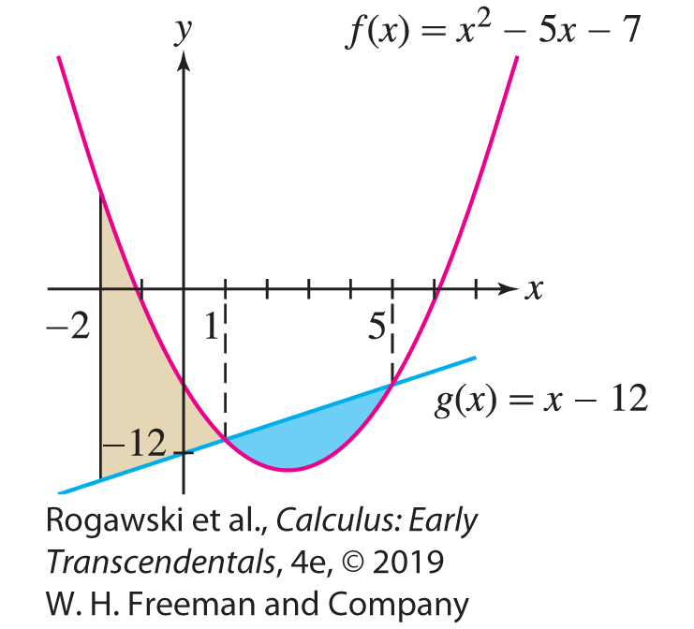

6.1 Area Between Two Curves (5 of 15)
Writing y_{top} = f (x) for the top curve and y_{bot} = g(x) for the bottom curve, we obtain a$rea between the curves=\int_{a}^{b}{(y_{top}}−y_{bot})dx$
EXAMPLE: We find the area between the graphs of
f (x) = x ² − 5x − 7 and g(x) = x − 12 over [−2, 5].
First, we must determine which graph lies on top. We know that y = f (x) is a parabola with y-intercept −7 and that y = g(x) is a line with y-intercept −12 (Figure 6).

Slide 7

6.1 Area Between Two Curves (6 of 15)
To determine where the graphs intersect, we solve f (x) = g(x), that is, f (x) − g(x) = 0:
f (x) − g(x) = (x ² − 5x − 7) − (x − 12) = x ² − 6x + 5 = (x − 1)(x − 5) = 0
that is, at x = 1 and x = 5. We see that f (x ) − g(x ) ≤ 0 for 1 ≤ x ≤ 5.
Thus, f (x ) ≥ g(x ) on [−2, 1] and g(x ) ≥ f (x ) on [1, 5]. This tells us to write the area A as a sum of integrals over the two intervals:
$\int_{−2}^{1}{(f\left(x\right)−g\left(x\right))}dx=\int_{−2}^{1}{(}\text{x} \text{2} \text{−} \text{6}\text{x} \text{+} \text{5}\text{)}\text{dx}\text{ = }\text{(}\frac{1}{3}x^{3}−3x^{2}+5x)|_{−2}^{1}=\frac{81}{3}$
$\int_{1}^{5}{\left(g\left(x\right)−f\left(x\right)\right)}dx=\int_{1}^{5}{−x^{2}+6x−5)}dx=\left(−\frac{1}{3}x^{3}+3x^{2}−5x\right)|_{1}^{5}=\frac{32}{3}$
Therefore, $A=\frac{81}{3}+\frac{32}{3}=\frac{113}{3}.$

Slide 8
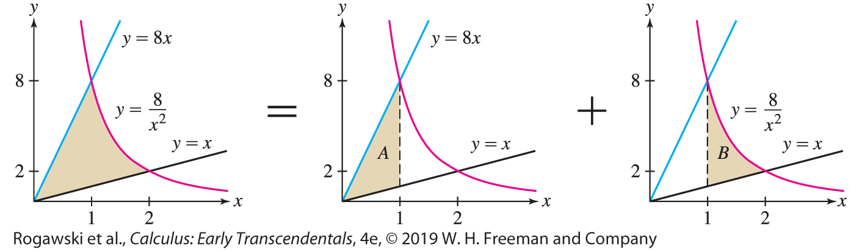

6.1 Area Between Two Curves (7 of 15)
EXAMPLE: Calculating Area by Dividing the Region We find the area of the region bounded by the graphs of y = 8/x ², y = 8x , and y = x .
Step 1. Sketch the region (especially, find any points of intersection).
The curve y = 8/x ² cuts off a region in the sector between the two lines y = 8x and y = x (Figure 7). We find the intersection of y = 8/x ² and y = 8x by solving $\frac{8}{x^{2}}=8x$ or $x^{3}=1,$ that is, x = 1. Similarly, the intersection of y = 8/x ² and y = x is the solution of $\frac{8}{x^{2}}=x$ or
$x^{3}=8,$ that is, x = 2.

Slide 9

6.1 Area Between Two Curves (8 of 15)
Step 2. Set up the integrals and evaluate.
Figure 7 shows that y_{bot} = x , but y_{top} changes at x = 1 from y_{top} = 8x to y_{top} = 8/x ². So, the region is not vertically simple. Therefore, we break up the regions into two parts, A and B, each vertically simple, and compute their areas separately.
a$rea A=\int_{0}^{1}{(8x−x)}dx=\int_{0}^{1}{7x}dx=\frac{7}{2}x^{2}|_{0}^{1}=\frac{7}{2}$
a$rea B=\int_{1}^{2}{(\frac{8}{x^{2}}−x)}dx=\left(−\frac{8}{x}−\frac{1}{2}x^{2}\right)|_{1}^{2}=\frac{5}{2}$
The total area is $A=\frac{7}{2}+\frac{5}{2}=6.$

Slide 10
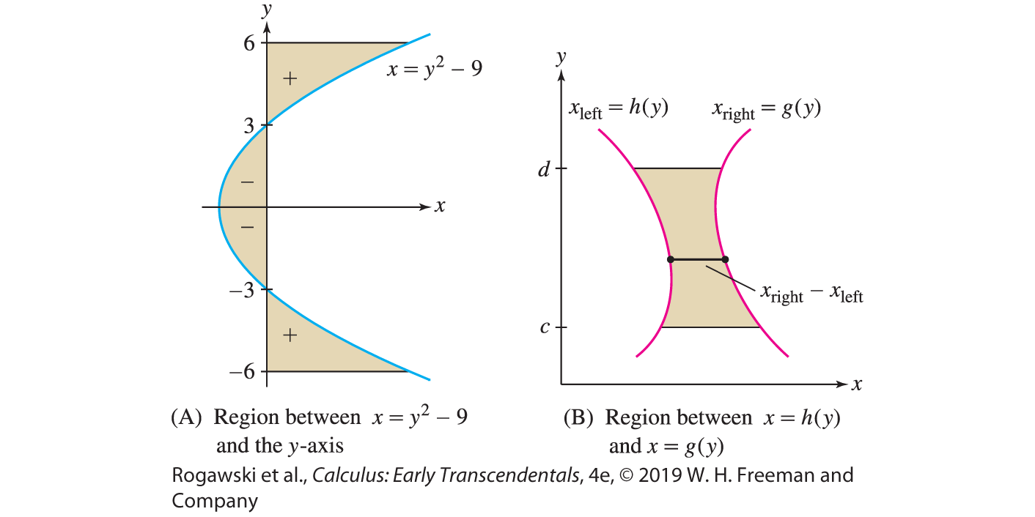

6.1 Area Between Two Curves (9 of 15)
Suppose we are given x as a function of y, say, x = g(y). What is the meaning of the integral $\int_{c}^{d}{g(y)}dy$? This integral can be interpreted as signed area, where regions to
the right of the y-axis have positive area and regions to the left have negative area:
$$\int_{c}^{d}{g(y)}dy\text{=} \text{signe}\text{d} \text{are}\text{a} \text{betwee}\text{n} \text{grap}\text{h} \text{an}\text{d} \text{y}\text{−}\text{axis} \text{f}\text{o}\text{r} \text{c} \text{≤} \text{y} \text{≤} \text{d}$$
In Figure 8(A), the part of the shaded region
to the left of the y-axis has a negative signed
area. The signed area of the entire region is
$\int_{−6}^{6}{(y^{2}−9)}dy=\left(\frac{1}{3}y^{3}−9y\right)|_{−6}^{6}=36$

Slide 11
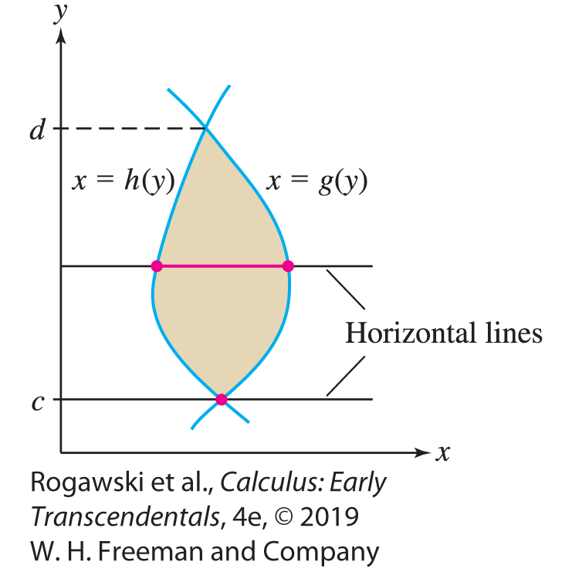

6.1 Area Between Two Curves (10 of 15)
More generally, if g(y) ≥ h(y) as in Figure 8(B), then the graph of x = g(y) lies to the right of the graph of x = h(y). In this case, we write x_{right} = g(y) and x_{left} = h(y) and we call the region horizontally simple, since every horizontal line that intersects the region does so in a single line segment or point such that the left endpoint is on the curve
x = h(y) and the right endpoint is on the curve x = g(y), as in Figure 9. The formula for the area corresponding to Eq. (2) is
$\text{a}\text{re}\text{a} \text{betwee}\text{n} \text{th}\text{e} \text{graph}\text{s} \text{=}$
$\int_{c}^{d}{\left(x_{right}−x_{left}\right)dy=\int_{c}^{d}{(g\left(y\right)−h\left(y\right))}}dy$

Slide 12
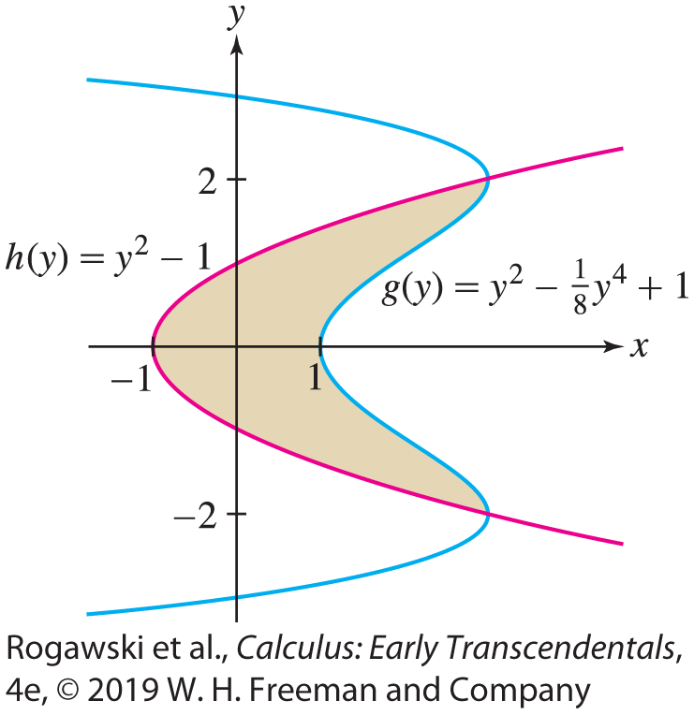


6.1 Area Between Two Curves (11 of 15)
EXAMPLE: We calculate the area enclosed by the graphs of h(y) = y² − 1 and $g\left(y\right)=y^{2}−\frac{1}{8}y^{4}+1$. Figure 10 shows that the enclosed region stretches between the two points of intersection of the graphs and that g(y) ≥ h(y) over the region. Therefore, the region is horizontally simple with x_{right} = g(y) and x_{left} = h(y). To set up the integral for the area, we need to determine the points of intersection. We solve g(y) = h(y) for y:
$y^{2}−\frac{1}{8}y^{4}+1=y^{2}−1$ or $y^{4}−16=0$, that is, $y=±2$
The enclosed area is
$$\int_{−2}^{2}{\left[\left(y^{2}−\frac{1}{8}y^{4}+1\right)−\left(y^{2}−1\right)\right]dy=\int_{−2}^{2}{\left(2−\frac{1}{8}y^{4}\right)}dy=\left(2y−\frac{1}{40}y^{5}\right)|_{−2}^{2}=\frac{32}{5}.}$$

Slide 13
6.1 Area Between Two Curves (12 of 15)
For many regions, we have a choice of whether to find the area by integrating with respect to x or with respect to y. The decision is usually based on two factors:
How easy it is to obtain the curves as functions of one variable in terms of the other
How easy it is to subdivide the region into simple regions and to integrate the functions involved
In the next example, we carry out the area computation, both integrating with respect to x and integrating with respect to y, demonstrating how these factors are involved.

Slide 14
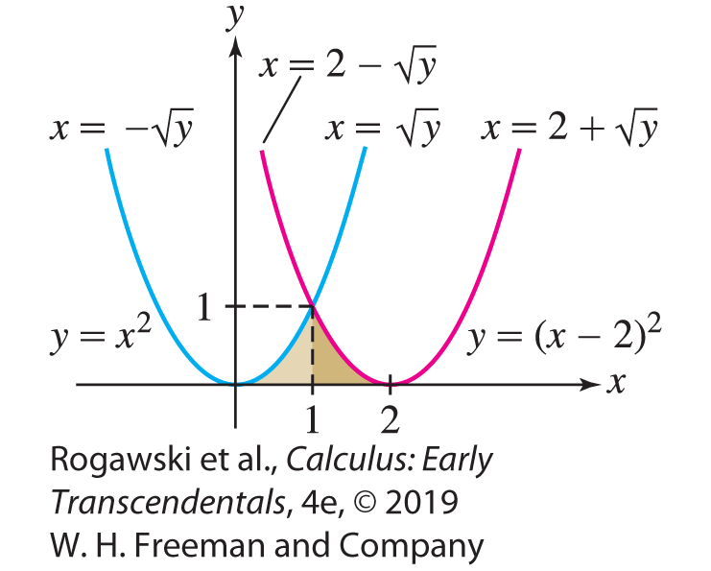
6.1 Area Between Two Curves (13 of 15)
EXAMPLE: Find the area of the region that is bounded by the three curves y = x², y = (x − 2)², and y = 0.
Solution The area appears in Figure 11. Notice immediately that it is not vertically simple, since the top function changes over the interval [0, 2]. It is horizontally simple, but to calculate the area using the fact it is a horizontally simple region takes some work to set up the expressions for x_{right} and x_{left}.

Slide 15

6.1 Area Between Two Curves (14 of 15)
We first compute the area of the region by splitting it into two vertically simple regions. In this case, the area is given by
$$\int_{0}^{1}{x^{2}}dx+\int_{1}^{2}{{(x−2)}^{2}}dx=\frac{1}{3}x^{3}|_{0}^{1}+\frac{1}{3}{(x−2)}^{3}|_{1}^{2}=\frac{2}{3}$$
Now, let’s redo the problem using the fact the region is horizontally simple. To determine x_{right} and x_{left}, we must invert the formulas for each of the parabolas. The left boundary of the region is the right side of the parabola given by y = x². Solving for x , $x=±\sqrt{y}$. The right side of the parabola corresponds to the positive choice, that is, $x_{left}=\sqrt{y}$. On the other hand, the right boundary of the region is the left side of the parabola y = (x − 2)². We solve for x: $x=2±\sqrt{y}$. The left side of the parabola is obtained by choosing the minus sign, and therefore x_{right} = 2 − $\sqrt{y}$.

Slide 16

6.1 Area Between Two Curves (15 of 15)
Now, let’s redo the problem using the fact the region is horizontally simple. To determine x_{right} and x_{left}, we must invert the formulas for each of the parabolas. The left boundary of the region is the right side of the parabola given by y = x². Solving for x , $x=±\sqrt{y}$. The right side of the parabola corresponds to the positive choice, so we have $x_{left}=\sqrt{y}$. Moreover, the right boundary of the region is the left side of the parabola y = (x − 2)². We solve for x and obtain $x=2±\sqrt{y}$. The left side of the parabola is obtained by choosing the minus sign, and therefore $x_{right}=2−\sqrt{y}$. The area is
$$\int_{0}^{1}{(}2−\sqrt{y}−\sqrt{y})dy=(2y−\frac{4}{3}y^{3/2})|_{0}^{1}=\frac{2}{3}$$

Slide 17
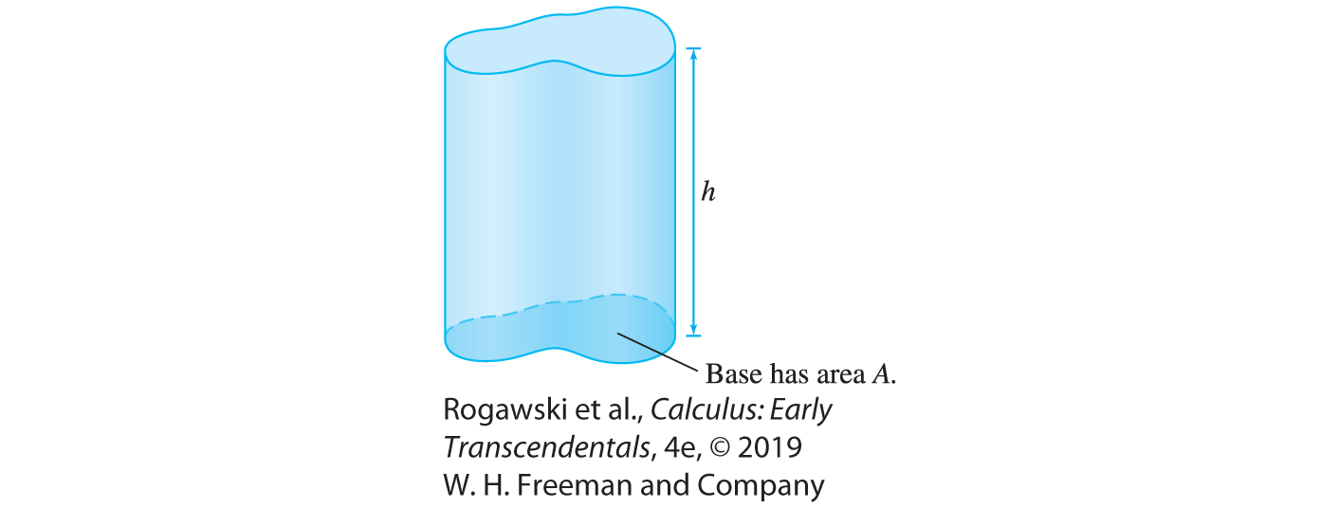
6.2 Setting Up Integrals: Volume, Density, Average Value (1 of 24)
Our first example is the volume of a solid body. Before proceeding, let’s recall that the volume of a right cylinder (Figure 1) is Ah, where A is the area of the base and h is the height, measured perpendicular to the base. Here, we use the “right cylinder” in the general sense; the base does not have to be circular, but the sides are perpendicular to the base.

Slide 18
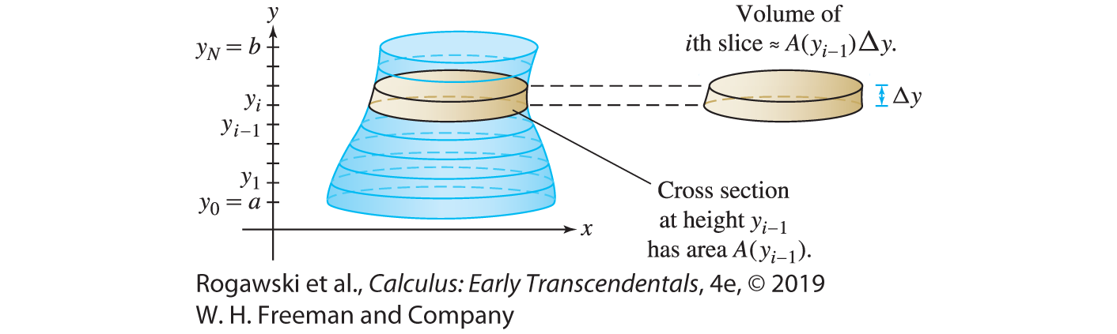
6.2 Setting Up Integrals: Volume, Density, Average Value (2 of 24)
Suppose that a solid body extends from height y = a to y = b along the y-axis as in Figure 2. Furthermore, assume that the area of the horizontal cross sections (the intersections of the solid with horizontal planes) vary from level to level within the solid. Let A(y) be the cross-sectional area at height y.

Slide 19

6.2 Setting Up Integrals: Volume, Density, Average Value (3 of 24)
To compute the volume V of the body, divide the body into N horizontal slices of thickness ∆ y = (b − a)/N . The ith slice extends from y_{i −1} to y_{i} , where y_{i} = a + i∆ y. Let V_{i} be the volume of the slice.
If N is very large, then ∆ y is very small and the slices are very thin. In this case, the ith slice is nearly a right cylinder of base A(y_{i −1}) and height ∆ y, and therefore
V_{i} ≈ A(y_{i −1}) ∆ y. The whole volume is obtained by summing the volumes of the slices, and therefore
$V=\sum_{i=1}^{N}{V_{i}≈}\sum_{i=1}^{N}{A(y_{i})∆y}$
The sum on the right is a left-endpoint approximation to the integral $\int_{a}^{b}{A(y)}dy.$

Slide 20

6.2 Setting Up Integrals: Volume, Density, Average Value (4 of 24)
If we assume that A is a continuous function, then the approximation improves in accuracy and converges to the integral as N →∞. We conclude that the volume of the solid is equal to the integral of its cross-sectional area.
Volume as the Integral of Cross-Sectional Area
Let A(y) be the area of the horizontal cross section at height y of a solid body extending from y = a to y = b. Then
$$\text{v}\text{olum}\text{e} \text{o}\text{f} \text{th}\text{e} \text{solid} \text{bod}\text{y} \text{=}\int_{a}^{b}{A(y)}dy (1)$$

Slide 21
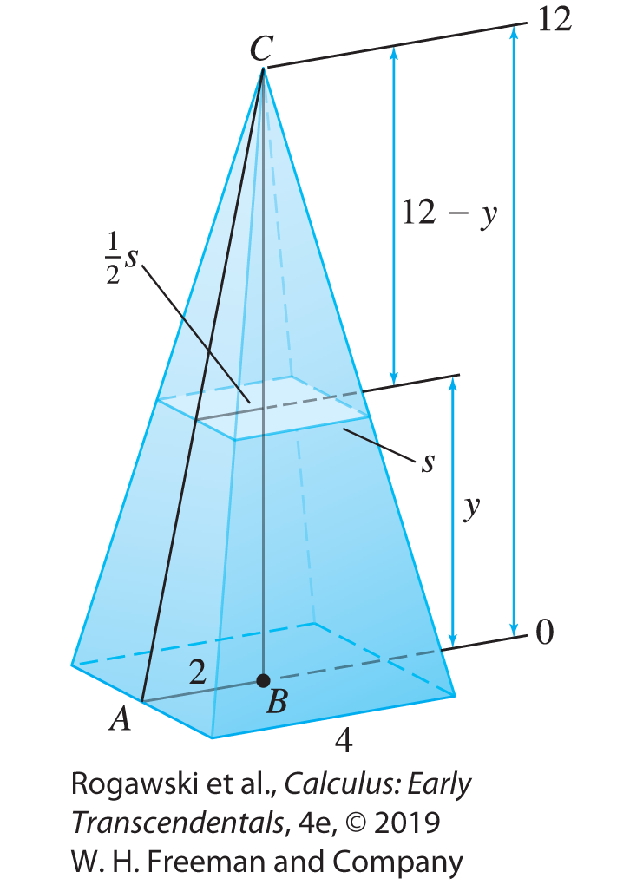

6.2 Setting Up Integrals: Volume, Density, Average Value (5 of 24)
EXAMPLE: Volume of a Pyramid We calculate the volume V of a pyramid of height 12 m whose base is a square of side 4 m. To use Eq. (1), we need a formula for the horizontal cross section A(y).
Figure 3 shows that the horizontal cross section at height y is a square. To find the side s of this square, apply the law of similar triangles to
∆ ABC and to the triangle of height 12 − y whose base of length s lies on the cross section: $\frac{base}{height}=\frac{2}{12}=\frac{1/2x}{12−y}$ or 2(12 − y) = 6s and
$s=\frac{1}{3}(12−y)$. Hence, $A\left(y\right)=\frac{1}{9}{(12−y)}^{2}.$
$V=\int_{0}^{12}{A(y)}dy=\int_{0}^{12}{\frac{1}{9}{(12−y)}^{2}}dy=−\frac{1}{27}{\left(12−y\right)}^{3}|_{0}^{12}=64{ m}^{3}$

Slide 22
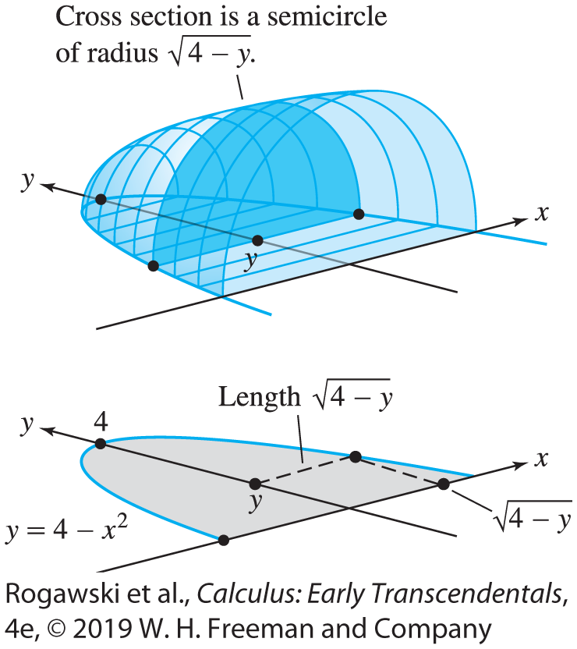

6.2 Setting Up Integrals: Volume, Density, Average Value (6 of 24)
EXAMPLE: Compute the volume V of the solid in Figure 4, whose base (shown at the bottom in the figure) is the region between the parabola y = 4 − x ² and the x-axis, and whose vertical cross sections perpendicular to the y-axis are semicircles. To find a formula for the area A(y) of the cross section, observe that y = 4 − x ² can be rewritten as
$x=±\sqrt{4 −y}$. We see in Figure 4 that the cross section at y is a semicircle of radius $r=\sqrt{4 −y}$. This semicircle has area $A\left(y\right)=\frac{π}{2}\left(4 −y\right).$
$$V=\int_{0}^{4}{A(y)}dy=\int_{0}^{4}{\frac{π}{2}\left(4 −y\right)}dy=\frac{π}{2}\left(4y−\frac{1}{2}y^{2}\right)|_{0}^{4}=4π$$

Slide 23
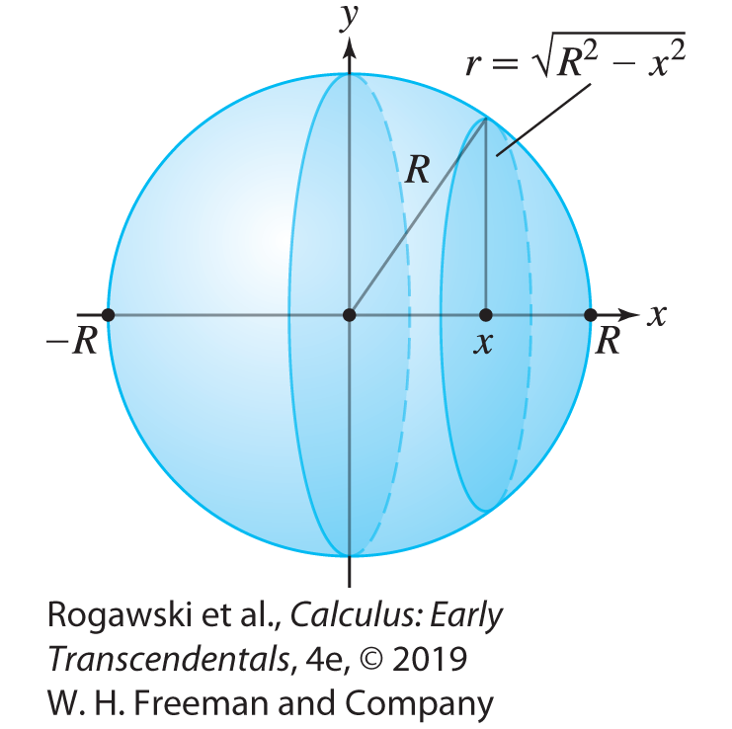

6.2 Setting Up Integrals: Volume, Density, Average Value (7 of 24)
Volume of a Sphere: Vertical Cross Sections Compute the volume of a sphere of radius R.
Solution As we see in Figure 5, the vertical cross section of the sphere at x is a circle whose radius r satisfies x ² + r ² = R² or $r=\sqrt{R^{2}−x^{2}}$. Note that R is the fixed radius of the sphere, while r varies as the cross sections vary. The area of the cross section is
A(x) = 𝜋r ² = 𝜋 (R² − x ²). Therefore, the sphere has volume
$$\int_{−R}^{R}{π(R^{2}−x^{2})}dx=π\left(R^{2}x−\frac{1}{3}x^{3}\right)|_{−R}^{R}=\frac{4}{3}πR^{3}$$

Slide 24
6.2 Setting Up Integrals: Volume, Density, Average Value (8 of 24)
Next, we show that the total mass of an object can be expressed as the integral of its mass density. Consider a rod of length L. The rod’s linear mass density ρ is defined as the mass per unit length. If ρ is constant, then by definition,
total mass = linear mass density × length = ρ · L (2)
For example, if L = 10 cm and ρ = 9 g/cm, then the total mass is ρ∙ L = 9 · 10 = 90 g.

Slide 25
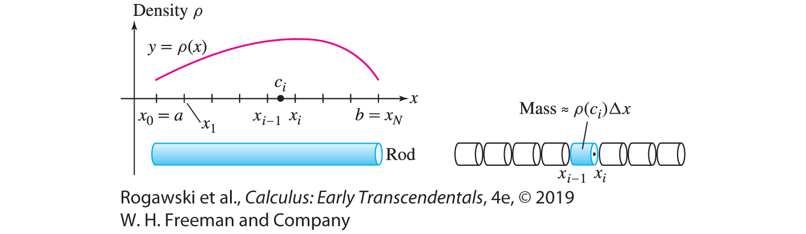

6.2 Setting Up Integrals: Volume, Density, Average Value (9 of 24)
Now, consider a rod extending along the x-axis from x = a to x = b whose density
y = ρ(x ) is a continuous function of x , as in Figure 7. To compute the total mass M, we break up the rod into N small segments of length ∆ x = (b − a)/N . Then
$$M=\sum_{i=1}^{N}{M_{i}}$$
where M_{i} is the mass of the ith segment.

Slide 26

6.2 Setting Up Integrals: Volume, Density, Average Value (10 of 24)
We cannot use Eq. (2) directly to find the mass of the rod because ρ(x) is not constant. However, we can argue that if ∆ x is small, then ρ(x) is nearly constant along the ith segment, and we can use Eq. (2) to obtain the mass of the ith segment. If the ith segment extends from x_{i −1} to x_{i} and c_{i} is any sample point in [x_{i −1}, x_{i} ], then M_{i} ≈ ρ(c_{i} ) ∆ x and
t$otal mass=\sum_{i=1}^{M}{M_{i}}=\sum_{i=1}^{N}{ρ(c_{i})∆x}$
As N → ∞, the accuracy of the approximation improves. However, the sum on the right is a Riemann sum whose value approaches $\int_{a}^{b}{ρ(x)}dx$, and thus it makes sense to define the total mass of a rod as the integral of its linear mass density:
$$total mass M =\int_{a}^{b}{ρ(x)}dx$$

Slide 27

6.2 Setting Up Integrals: Volume, Density, Average Value (11 of 24)
EXAMPLE: Total Mass Find the total mass M of a 2-m rod of density ρ(x) = 1 + 2x − x ² kg/m, where x is the distance from one end of the rod:
$$M=\int_{0}^{2}{\left(1+2x−x^{2}\right)}dx=\left(x+x^{2}−\frac{1}{3}x^{3}\right)|_{0}^{2}=\frac{10}{3} kg$$
We continue with other applications of density functions. In some situations, density is a function of distance to the origin. For example, in the study of urban populations, it might be assumed that the population density ρ(r) (in people per square kilometer) depends only on the distance r from the center of a city. Such a density function is called a radial density function.

Slide 28
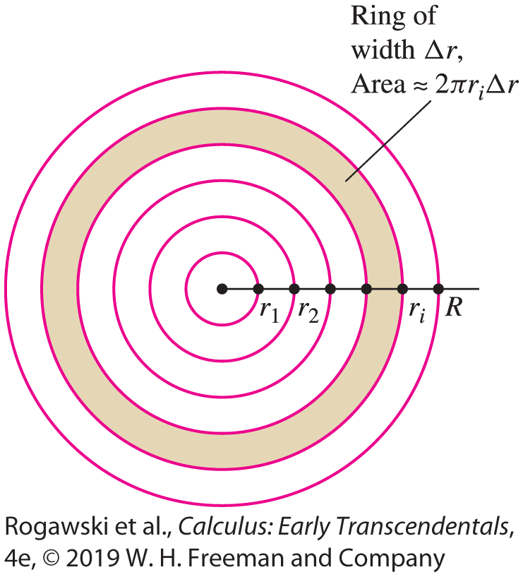

6.2 Setting Up Integrals: Volume, Density, Average Value (12 of 24)
We now derive a formula for the total population P within a radius R of the city center, assuming a radial density ρ(r). First, divide the circle of radius R into N thin rings of equal width ∆ r = R/N as in Figure 8.
Let P_{i} be the population within the ith ring, so that the total population is given by $P=\sum_{i=1}^{N}{P_{i}}$. If the outer radius of the ith ring is r_{i} , then the circumference is 2πr_{i} , and if ∆ r is small, the area of this ring is approximately 2πr_{i} ∆ r (outer circumference times width). Furthermore, the population density within the thin ring is nearly constant with value ρ(r_{i}).

Slide 29

6.2 Setting Up Integrals: Volume, Density, Average Value (13 of 24)
With these approximations, P_{i} ≈ $2πr_{i}ρ(r_{i})∆r$ and $P=\sum_{i=1}^{N}{P_{i}}=\sum_{i=1}^{N}{2πr_{i}ρ(r_{i})}∆r$ which converges to $\int_{0}^{R}{2πrρ(r)}dr$ as N → ∞. Thus, for a population with a radial density function ρ,
p$opulation P within a radius R =\int_{0}^{R}{2πrρ(r)}dr$

Slide 30

6.2 Setting Up Integrals: Volume, Density, Average Value (14 of 24)
EXAMPLE: Computing Total Population The population in the city of Isaactonia and its surrounding suburbs has radial density function ρ(r ) = 15(1 + r ²)^{−1/2}, where r is the distance from the city center in kilometers and ρ has units of thousands per square kilometer. How many people live in the ring between 10 and 30 km from the city center?
Solution The population P (in thousands) within the ring is
$$P=2π\int_{10}^{30}{15\frac{r}{\sqrt{1+r^{2}}}dr=30π\int_{101}^{901}{\frac{1}{2}u^{−1/2}dr}=30π\sqrt{u}}|_{101}^{901}≈ 1,882,000$$
In other words, the population in the ring is approximately 1.9 million people.

Slide 31
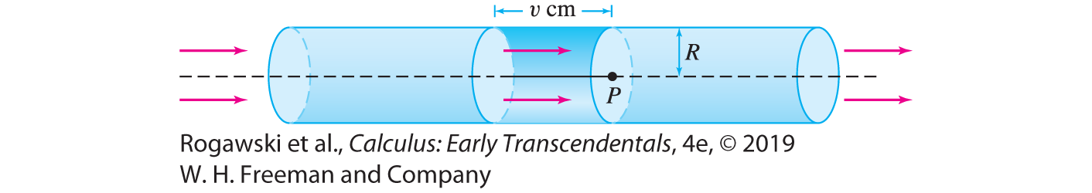
6.2 Setting Up Integrals: Volume, Density, Average Value (15 of 24)
When fluid flows through a tube, the flow rate Q is the volume per unit time of fluid passing through the tube (Figure 9). The flow rate depends on the velocity of the fluid particles. If all particles of the fluid travel with the same velocity v (say, in units of cubic meters per minute), and the tube has radius R, then
flow rate Q = cross-sectional area × velocity = π R²v cm³/min
Fix an observation point P. A particle travels v cm/min, so it flows past P during this minute if it is located not more than v centimeters to the left of P (assuming the fluid flows from left to right). Therefore, the column of fluid flowing past P in a 1-min interval is a cylinder of radius R, length v, and volume π R²v (Figure 9).

Slide 32

6.2 Setting Up Integrals: Volume, Density, Average Value (16 of 24)
In reality, the fluid particles do not all travel at the same velocity because of friction. However, for a slowly moving fluid, the flow is laminar, by which we mean that the velocity v(r) depends only on the distance r from the center of the tube. The particles at the center of the tube travel most quickly, and the velocity tapers off to zero near the walls of the tube (Figure 10).

Slide 33
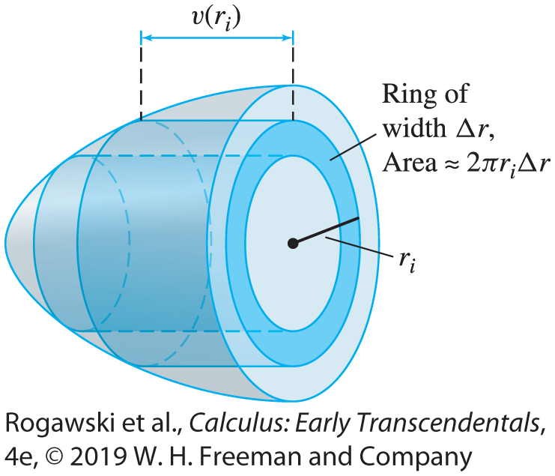

6.2 Setting Up Integrals: Volume, Density, Average Value (17 of 24)
If the flow is laminar, we can express the flow rate Q as an integral. We divide the circular cross section of the tube into N thin concentric rings of width Δ r = R/N (Figure 11). The area of the ith ring is approximately 2π r_{i} Δ r and the fluid particles flowing past this ring have a velocity that is nearly constant with value v(r_{i}). Therefore, we can approximate the flow rate Q_{i} through the ith ring by
Q_{i} ≈ cross-sectional area × velocity ≈ (2π r_{i} Δ r )v(r_{i})
We obtain $Q=\sum_{i=1}^{N}{Q_{i}}=\sum_{i=1}^{N}{2πr_{i}v(r_{i})}∆r$. Once again, we let N tend to ∞ to obtain the formula for laminar flow with velocity v(r):
f$low rate Q =2π\int_{0}^{R}{rv(r)}dr (5)$

Slide 34

6.2 Setting Up Integrals: Volume, Density, Average Value (18 of 24)
EXAMPLE: Laminar Flow According to Poiseuille’s Law, the velocity of blood flowing in a blood vessel of radius R centimeters is v(r) = k(R² − r²), where r is the distance from the center of the vessel (in centimeters) and k is a constant. Calculate the flow Q as function of R, assuming that k = 0.5 (cm-s)⁻¹.
Solution By Eq. (5),
$$Q=2π\int_{0}^{R}{\frac{1}{2}}r\left(R^{2}−r^{2}\right)dr=2π\left(\frac{1}{4}R^{2}r^{2}−\frac{1}{8}r^{4}\right)|_{0}^{R}=\frac{π}{4}R^{4}$$
Note that Q is proportional to R⁴ (this is true for any value of k).

Slide 35

6.2 Setting Up Integrals: Volume, Density, Average Value (19 of 24)
As a final example, we discuss the average value of a function. Recall that the average of N numbers a₁, a₂, ... , a_{N} is the sum divided by N :
$$\frac{a_{1}+a_{2}+⋯a_{N}}{N}$$
We cannot define the average value of a function f on an interval [a, b] as a sum because there are infinitely many values of x to consider. But recall the formula for the right-endpoint approximation R_{N} (Figure 12):
$$R_{N}=\frac{b−a}{N}(f \left(x1\right)+ f \left(x2\right)+ ··· + f \left(xN\right))$$
where x₁ , ... , x_{N} are the right endpoints of the subintervals. We see that R_{N} divided by (b – a) gives $\frac{R_{N}}{b − a}=\frac{f \left(x1\right) + f \left(x2\right) + ··· + f \left(xN\right)}{N}$. If N is large, it is reasonable to think of this quantity as an approximation to the average of f (x ) on [a, b].

Slide 36
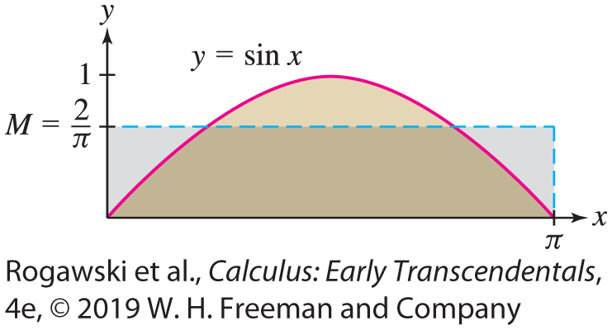

6.2 Setting Up Integrals: Volume, Density, Average Value (20 of 24)
Therefore, we define the average value itself as the limit:
a$verage value =\lim_{N→∞}{\frac{R_{N}(f)}{b − a}}=\frac{1}{b − a}\int_{a}^{b}{f(x)}dx$
DEFINITION: Average Value
The average value of an integrable function f on [a, b] is the quantity
a$verage value =\lim_{N→∞}{\frac{R_{N}(f)}{b − a}}=\frac{1}{b − a}\int_{a}^{b}{f(x)}dx$
EXAMPLE: The average value of f (x ) = sin x
on [0, π ] is $\frac{1}{π}\int_{0}^{π}{\sin{t}}dt=−\frac{1}{π}\cos{t}|_{0}^{π}=\frac{2}{π}$.

Slide 37
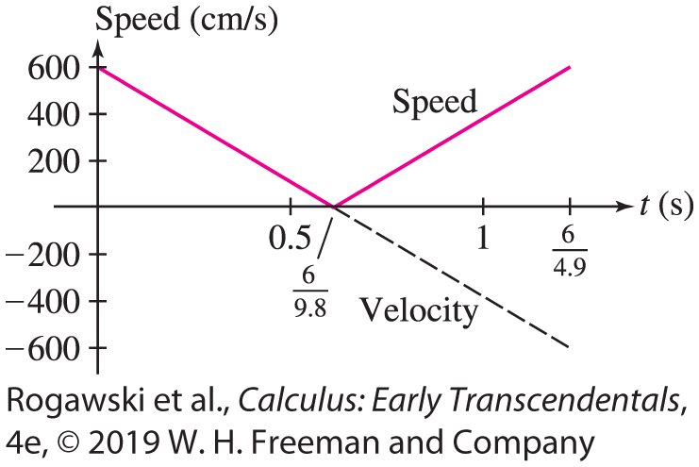

6.2 Setting Up Integrals: Volume, Density, Average Value (21 of 24)
EXAMPLE: Vertical Jump of a Bushbaby The bushbaby (Galago senegalensis) is a small primate with remarkable jumping ability. Find the average speed during a jump if the initial vertical velocity is v₀ = 600 cm/s. Use Galileo’s formula for the height
$h\left(t\right)=v_{0}t−\frac{1}{2}gt^{2}$ (in centimeters, where g = 980 cm/s²).

Slide 38

6.2 Setting Up Integrals: Volume, Density, Average Value (22 of 24)
Solution
The bushbaby’s height at time t is $h\left(t\right)=v_{0}t−\frac{1}{2}gt^{2}$. The height is zero at t = 0 and at $t=\frac{2v_{0}}{g}=\frac{6}{4.9}s.$ The bushbaby’s velocity is h'(t ) = v₀ − gt = 600 − 980t .
The velocity is negative for $t>\frac{v_{0}}{g}=\frac{6}{9.8} s.$ As we see in Figure 14, the integral of speed |h (t )| is equal to the sum of the areas of two triangles of base $\frac{6}{9.8}$ and height 600:
$\int_{0}^{6/{4.9}}{|600−980t|}dt=\frac{3600}{9.8}$
Over the time interval [0, $\frac{6}{4.9}$], the average value of the speed is $v_{ave}=\frac{{3600}/{9.8}}{6/{4.9}}=300\frac{m}{s}.$

Slide 39
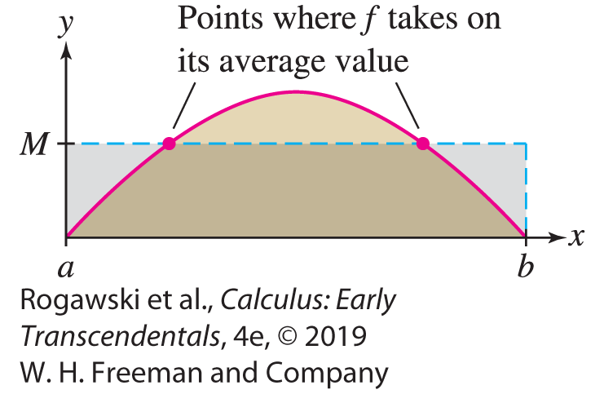

6.2 Setting Up Integrals: Volume, Density, Average Value (23 of 24)
There is an important difference between the average of a list of numbers and the average value of a continuous function. If the average score on an exam is 84, then 84 lies between the highest and lowest scores, but it is possible that no student received a score of
84. By contrast, the Mean Value Theorem (MVT) for Integrals asserts that a continuous function always takes on its average value somewhere in the interval (Figure 15).
THEOREM: Mean Value Theorem for Integrals
If f is continuous on [a, b], then there exists a value
c ∈ [a, b] such that
$$f\left(c\right)=\frac{1}{b−a}\int_{a}^{b}{f(x)}dx$$

Slide 40

6.2 Setting Up Integrals: Volume, Density, Average Value (24 of 24)
Proof Let $M=\frac{1}{b − a}\int_{a}^{b}{f(x)}dx$ be the average value. Because f is continuous, we can apply the results of Section 4.2 to conclude that f takes on a minimum value m_{min} and a maximum value M_{max} on the closed interval [a, b]. Furthermore,
$$m_{min}\left(b−a\right)≤\int_{a}^{b}{f\left(x\right)}dx≤M_{max}\left(b−a\right)$$
by Section 5.2. Therefore, $m_{min}≤M≤M_{max}$ and there is $c∈[a, b]$ such that f(c) = M by the Intermediate Value Theorem.
For example, the average of f (x) = sin x on [0, π ] is 2/π by a previous example. We have f(c) = 2/π for c = sin⁻¹(2/π ) ≈ 0.69. Since 0.69 lies in [0, π ], f (x) = sin x indeed takes on its average value at a point in the interval.

Slide 41
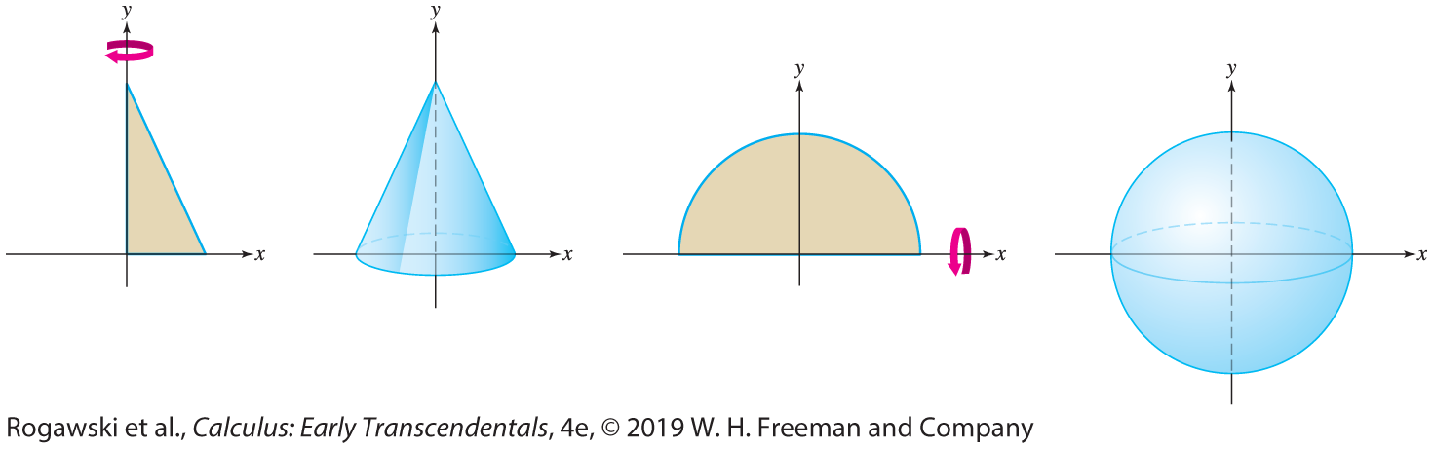
6.3 Volumes of Revolution: Disks and Washers (1 of 15)
A solid of revolution is a solid obtained by rotating a region in the plane about an axis. The sphere and right circular cone are familiar examples of such solids. Each of these is “swept out” as a plane region revolves around an axis (Figure 1).

Slide 42

6.3 Volumes of Revolution: Disks and Washers (2 of 15)
Suppose that f (x) ≥ 0 for a ≤ x ≤ b. The solid obtained by rotating the region under the graph about the x-axis has a special feature: All vertical cross sections are circles (Figure 2). In fact, the vertical cross section at location x is a circle of radius R = f (x ) and thus,
area of the vertical cross section = π R² = π f (x )²
We know from Section 6.2 that the total volume V is equal to the integral of cross-
sectional area. Therefore,
$$V=\int_{a}^{b}{πf\left(x\right)2}dx$$

Slide 43
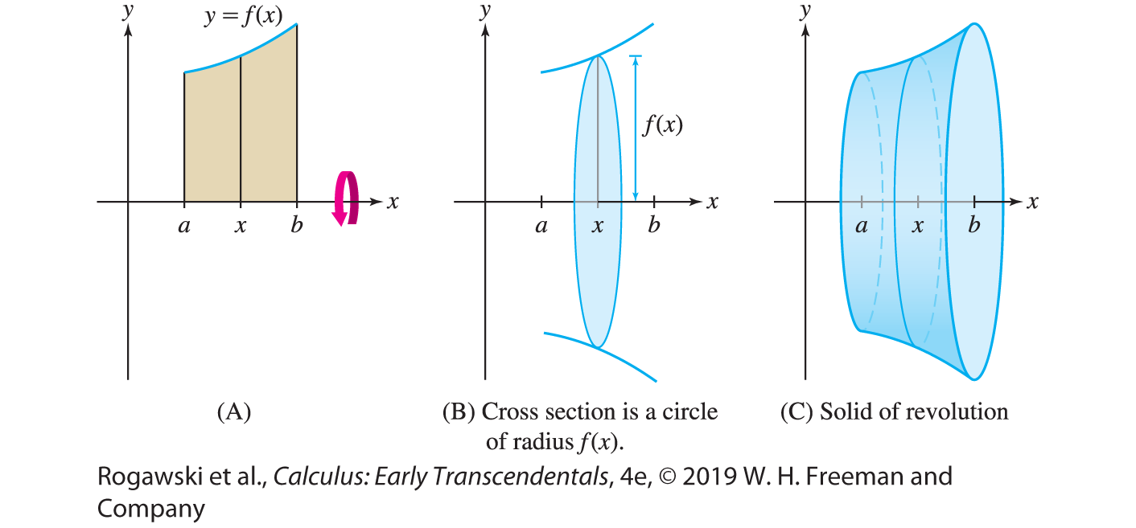

6.3 Volumes of Revolution: Disks and Washers (3 of 15)
Volume of Revolution: Disk Method If f is continuous and f (x) ≥ 0 on [a, b], then the solid obtained by rotating the region under the graph about the x -axis has volume [with
R = f (x)]:
$$V=\int_{a}^{b}{πR^{2}}dx=\int_{a}^{b}{πf\left(x\right)2}dx$$

Slide 44
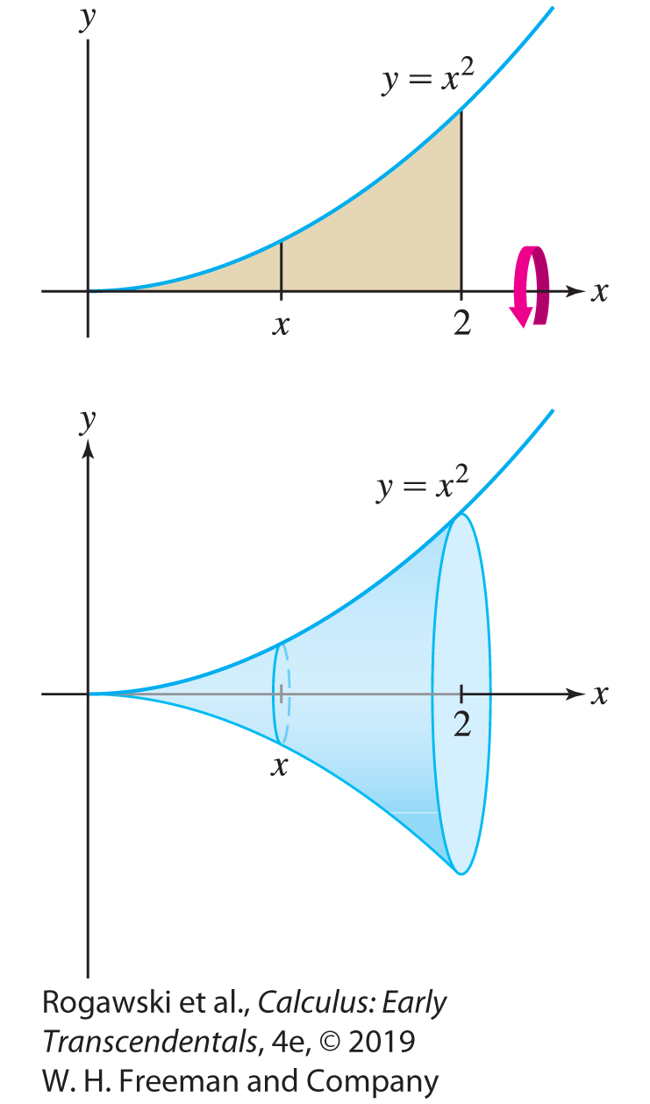

6.3 Volumes of Revolution: Disks and Washers (4 of 15)
EXAMPLE: Calculate the volume V of the solid obtained by rotating the region under y = x ² about the x-axis for 0 ≤ x ≤ 2.
Solution The solid is shown in Figure 3. By Equation (1) with f (x) = x ², its volume is
$$V=\int_{0}^{2}{πR^{2}}dx=\int_{0}^{2}{πx^{4}}dx=\frac{π}{5}x^{5}|_{0}^{2}=\frac{32π}{5}$$

Slide 45
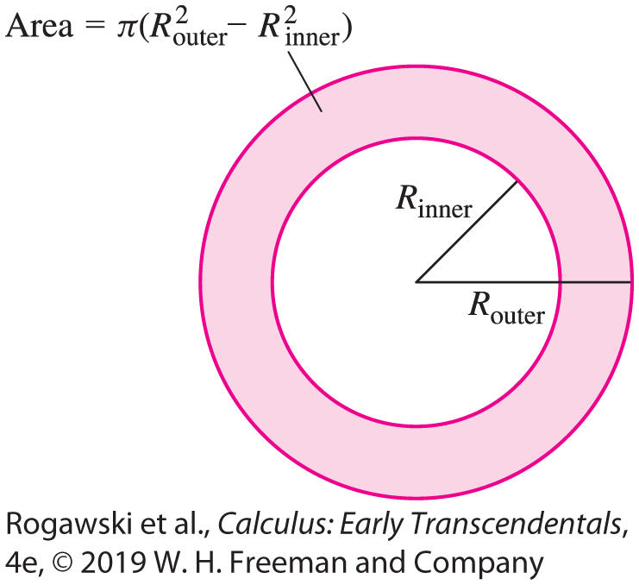

6.3 Volumes of Revolution: Disks and Washers (5 of 15)
There are some useful variations on the formula for a volume of revolution. First, consider the region between two curves y = f (x) and y = g(x), where f (x) ≥ g(x) ≥ 0 as in Figure 5(A). When this region is rotated about the x-axis, segment AB sweeps out the washer shown in Figure 5(B). The inner and outer radii of this washer (also called an annulus; see Figure 4) are R_{outer} = f (x), R_{inner} = g(x). The washer has area
$$π\left(R_{outer}^{2}−R_{inner}^{2}\right)=π({f\left(x\right)}^{2}−{g\left(x\right)}^{2})$$

Slide 46
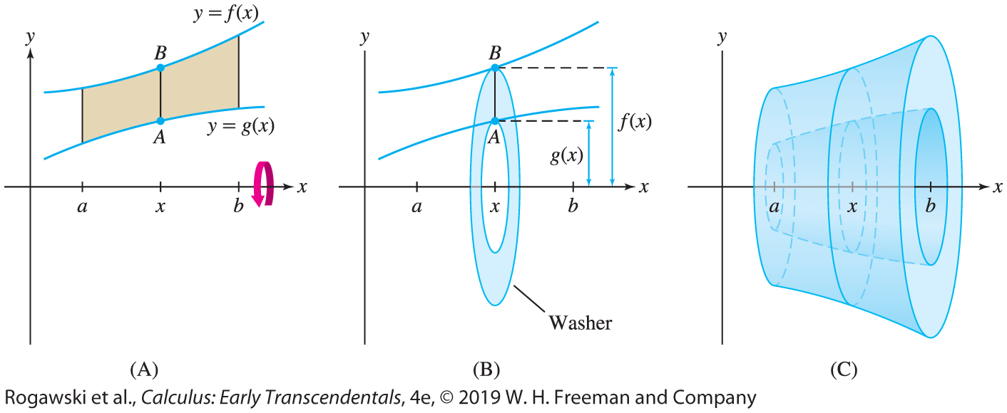

6.3 Volumes of Revolution: Disks and Washers (6 of 15)
$$\text{T}\text{h}\text{e} \text{volume} \text{o}\text{f} \text{t}\text{h}\text{e} \text{solid} \text{of} \text{revolution} \text{[}\text{Figure}\text{ 5(}\text{C}\text{)] }\text{is} \text{the} \text{integral} \text{of} \text{this} \text{cross}\text{−}\text{sectional} \text{area}\text{:}$$
$$V=\int_{a}^{b}{π\left(R_{outer}^{2}−R_{inner}^{2}\right)}dx=\int_{a}^{b}{π({f\left(x\right)}^{2}−{g\left(x\right)}^{2}) }dx$$
Keep in mind that the
integrand is
( f (x )² − g(x )²), not
( f (x ) − g(x ))².

Slide 47
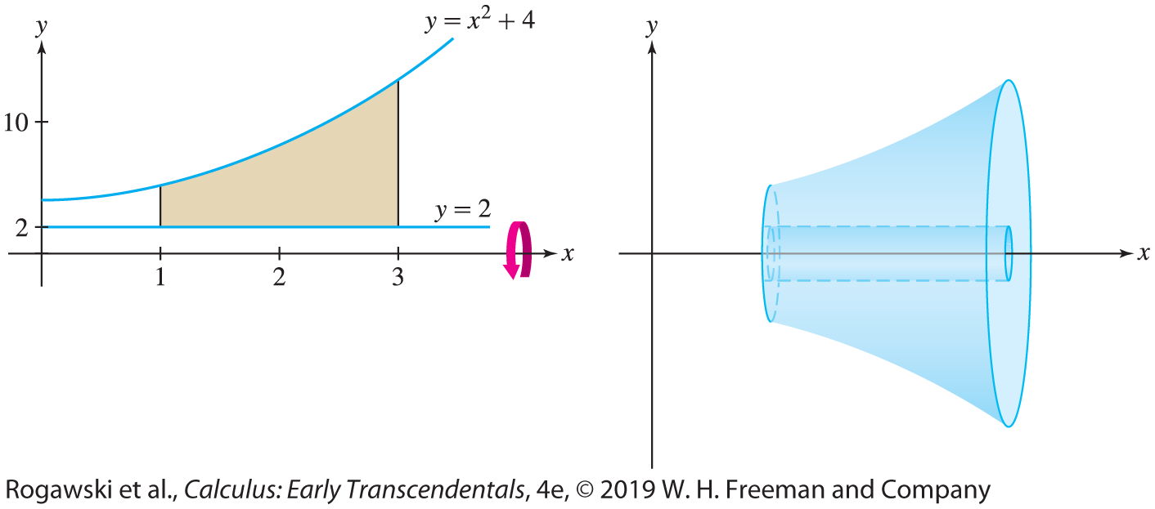

6.3 Volumes of Revolution: Disks and Washers (7 of 15)
EXAMPLE: Region Between Two Curves Find the volume V obtained by revolving the region between y = x ² + 4 and y = 2 about the x-axis for 1 ≤ x ≤ 3.
Solution The graph of y = x²+ 4 lies above the graph of y = 2 (Figure 6). Therefore,
R_{outer} = x ² + 4 and R_{inner} = 2. Then
$$V=\int_{1}^{3}{π\left(R_{outer}^{2}−R_{inner}^{2}\right)}dx=\int_{1}^{3}{π({\left(x^{2}+4\right)}^{2}−4)}dx=\int_{1}^{3}{π(x^{4}+8x^{2}+12)}dx$$
$=π\left(\frac{1}{5}x^{5}+\frac{8}{3}x^{3}+12x\right)|_{1}^{3}=\frac{2126}{15}$

Slide 48
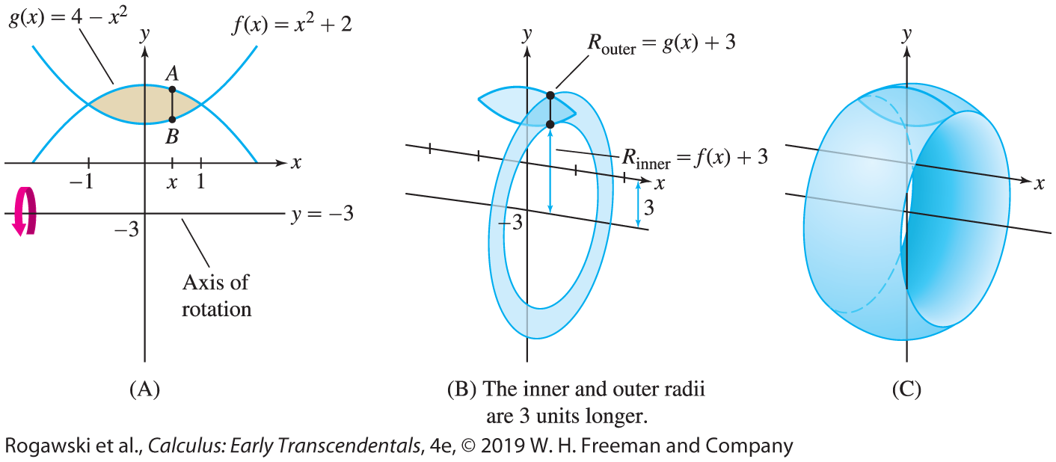
6.3 Volumes of Revolution: Disks and Washers (8 of 15)
In the next example, we calculate a volume of revolution about a horizontal axis parallel to the x-axis.
EXAMPLE: Revolving About a Horizontal Axis Find the volume V of the “wedding band” [Figure 7(C)] obtained by rotating the region between the graphs of
f (x ) = x ² + 2 and g(x ) = 4 − x ²
about the horizontal line y = −3.

Slide 49
6.3 Volumes of Revolution: Disks and Washers (9 of 15)
Solution First, let’s find the points of intersection of the two graphs by solving
f(x) = g(x), that is, x² + 2 = 4 – x². Hence, x² = 1 or x = ±1. Figure 7(A) on the previous slide shows that g(x) ≥ f (x) for −1 ≤ x ≤ 1.
If we wanted to revolve about the x-axis, we would use Eq. (2). Since we want to revolve around y = −3, we must determine how the radii are affected. Figure 7(B) shows that when we rotate about y = −3, AB generates a washer whose outer and inner radii are both 3 units longer, and therefore we have
• R_{outer} = g(x ) − (−3) = (4 − x ²) + 3 = 7 − x ²
• R_{inner} = f (x ) − (−3) = (x ² + 2) + 3 = x ² + 5

Slide 50

6.3 Volumes of Revolution: Disks and Washers (10 of 15)
The volume of revolution is equal to the integral of the area of this washer:
$$V=\int_{−1}^{1}{π\left(R_{outer}^{2}−R_{inner}^{2}\right)}dx$$
$$=\int_{−1}^{1}{π({\left(7−x^{2}\right)}^{2}−{\left(x^{2}+5\right)}^{2})}dx$$
$$=π\int_{−1}^{1}{\left(24−24x^{2}\right)}dx=π\left(24x−8x^{3}\right)|_{−1}^{1}=32π$$

Slide 51
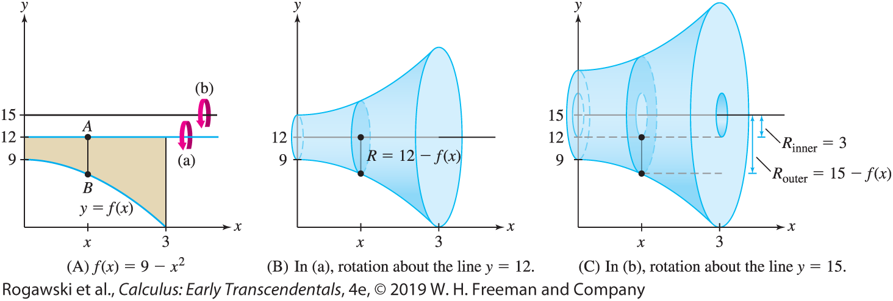
6.3 Volumes of Revolution: Disks and Washers (11 of 15)
EXAMPLE: Find the volume obtained by rotating the graphs of f (x) = 9 − x ² and
y = 12 for 0 ≤ x ≤ 3 about (a) the line y = 12 and (b) the line y = 15.
The resulting solids are illustrated in Figure 8.

Slide 52

6.3 Volumes of Revolution: Disks and Washers (12 of 15)
Solution To set up the integrals, let’s visualize the cross section. Is it a disk or a washer?
(a) Figure 8(B) shows that AB rotated about y = 12 generates a disk of radius R = length of AB = 12 − f (x) = 12 − (9 − x ²) = 3 + x ².
The volume when we rotate about y = 12 is
$$V=π\int_{0}^{3}{R^{2}}dx=π\int_{0}^{3}{{\left(3+x^{2}\right)}^{2}}dx$$
$$=π\int_{0}^{3}{(9+6x^{2}+x^{4})}dx=π\left(9x+2x^{3}+\frac{1}{5}x^{5}\right)|_{0}^{3}=\frac{648}{5}π$$

Slide 53

6.3 Volumes of Revolution: Disks and Washers (13 of 15)
(b) Figure 8(C) shows that AB rotated about y = 15 generates a washer. The outer radius of this washer is the distance from B to the line y = 15:
R_{outer} = 15 − f (x) = 15 − (9 − x ²) = 6 + x ²
The inner radius is R_{inner} = 3, so the volume of revolution about y = 15 is
$$V=\int_{−1}^{1}{π\left(R_{outer}^{2}−R_{inner}^{2}\right)}dx=π\int_{0}^{3}{({\left(6+x^{2}\right)}^{2}−9)}dx$$
$$=π\int_{0}^{3}{(x^{4}+12x+27)}dx=π\left(\frac{1}{5}x^{5}+6x^{2}+27x\right)|_{0}^{3}=\frac{1188}{5}π$$

Slide 54
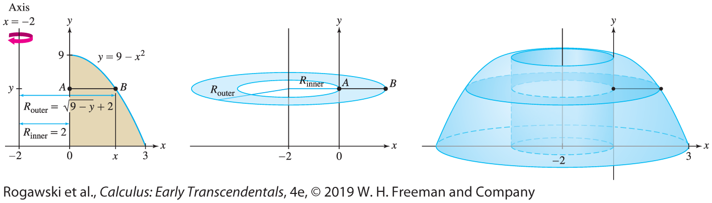
6.3 Volumes of Revolution: Disks and Washers (14 of 15)
We can use the disk and washer methods for solids of revolution about vertical axes, but it is necessary to describe the graph as a function of y—that is, x = g(y).
EXAMPLE: Revolving About a Vertical Axis Find the volume of the solid obtained by rotating the region under the graph of f (x) = 9 − x² for 0 ≤ x ≤ 3 about the vertical axis x = −2.

Slide 55

6.3 Volumes of Revolution: Disks and Washers (15 of 15)
Solution Figure 9 shows that AB sweeps out a horizontal washer when rotated about the vertical line x = −2. We are going to integrate with respect to y, so we need the inner and outer radii of this washer as functions of y. Solving for x in y = 9 − x ², we obtain that $x=±\sqrt{9−y}$. Since we are rotating the right half of the parabola, we choose the positive square root. Therefore, $R_{outer}=\sqrt{9−y}+2$ and $R_{inner}=2.$Hence,
$$R_{outer}^{2}−R_{inner}^{2}={\left(\sqrt{9−y}+2\right)}^{2}−4=9−y+4\sqrt{9−y}$$
$$V=π\int_{0}^{9}{\left(R_{outer}^{2}−R_{inner}^{2}\right)}dx$$
$$=π\int_{0}^{9}{(9−y}+4{\left(9−y\right)}^{1/2})dy=π\left(9y−\frac{1}{2}y^{2}−\frac{8}{3}{\left(9−y\right)}^{3/2}\right)|_{0}^{9}=\frac{225}{2}π$$

Slide 56
6.4 Volumes of Revolution: Cylindrical Shells (1 of 10)
The Shell Method, based on dividing a solid into concentric cylindrical shells, is more convenient in some cases. Consider a cylindrical shell (Figure 1) of height h, with outer radius R and inner radius r . Because the shell is obtained by removing a cylinder of radius r from the wider cylinder of radius R, it has volume
π R²h − πr ²h = πh(R² − r ²) = πh(R + r )(R − r ) = πh(R + r )∆ r
where ∆ r = R − r is the width of the shell. If the shell is very thin, then R and r are nearly equal and we may replace (R + r ) by 2R to obtain
volume of shell ≈ 2π Rh ∆ r = 2π (radius) × height of shell × thickness
This is the surface area of the outer cylinder times its thickness ∆ r.

Slide 57

6.4 Volumes of Revolution: Cylindrical Shells (2 of 10)
Now, let us rotate the region under y = f (x) from x = a to x = b about the y-axis as in Figure 2. The resulting solid can be divided into thin concentric shells. More precisely, we divide [a, b] into N subintervals of length ∆ x = (b − a)/N with endpoints x₀, x₁, ... , x_{N} . When we rotate the thin strip of area above [x_{i −1}, x_{i} ] about the y-axis, we obtain a thin shell whose volume we denote by V_{i} . The volume of the solid is equal to $V=\sum_{i=1}^{N}{V_{i}}.$

Slide 58
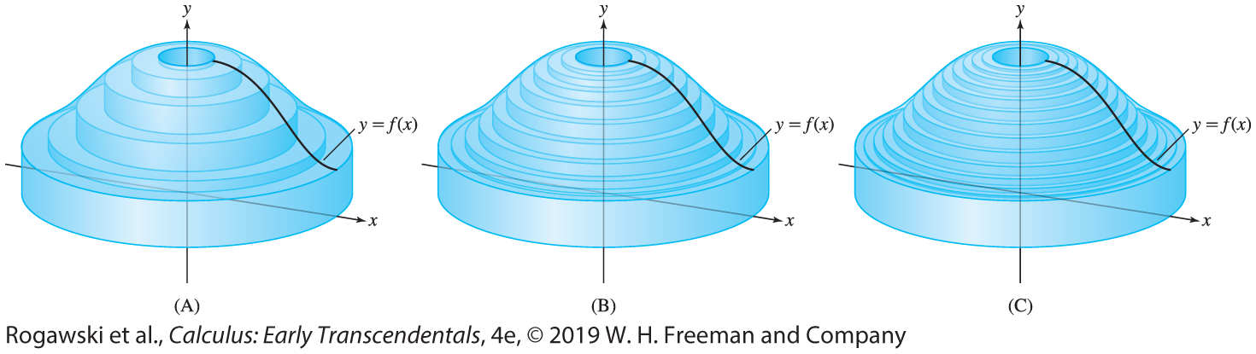

6.4 Volumes of Revolution: Cylindrical Shells (3 of 10)
The top rim of the ith thin shell in Figure 2 is curved. However, when ∆ x is small, we can approximate this thin shell by the cylindrical shell (with flat rim) of height f (x_{i}) and radius x_{i}. Then, using Eq. (1), we obtain V_{i} ≈ 2π (radius) (height of shell) (thickness) = 2πx_{i} f (x_{i})∆ x. Thus, $V=\sum_{i=1}^{N}{V_{i}}=\sum_{i=1}^{N}{2πx_{i}f(x_{i})∆x}$. The sum on the right is the volume of a cylindrical shell approximation that converges to V $=2π\int_{a}^{b}{xf(x)}dx$ as N →∞ (Figure 3).

Slide 59

6.4 Volumes of Revolution: Cylindrical Shells (4 of 10)
Thus, we obtain the volume of the solid:
Volume of Revolution: The Shell Method
The solid obtained by rotating the region under y = f (x) over the interval [a, b] about the y-axis has volume
$$V=2π\int_{a}^{b}{\text{radiu}\text{s}∙\text{heigh}\text{t} \text{o}\text{f} \text{shel}\text{l}∙\text{d}\text{x}=2π\int_{a}^{b}{xf\left(x\right)}dx.}$$

Slide 60
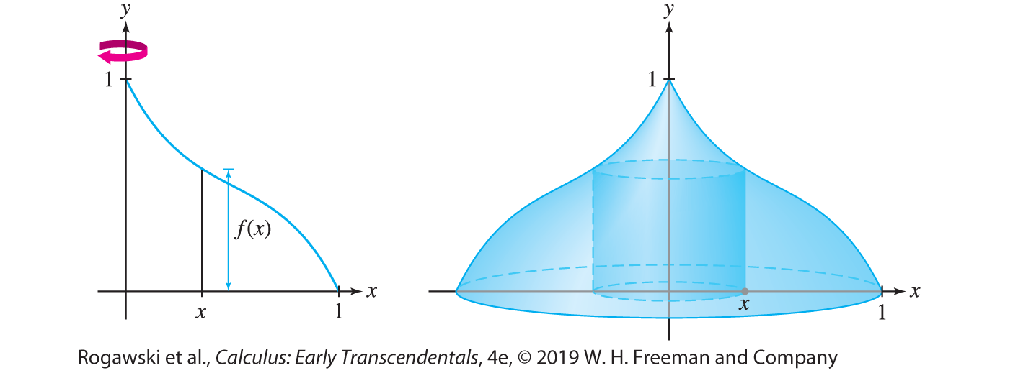

6.4 Volumes of Revolution: Cylindrical Shells (5 of 10)
EXAMPLE: Find the volume V of the solid obtained by rotating the region under the graph of f (x) = 1 − 2x + 3x ² − 2x ³ over [0, 1] about the y-axis.
Solution The solid is shown in Figure 4. By Eq. (2),
$$V=2π\int_{0}^{1}{(x−2x^{2}+3x^{3}−2x^{4})}dx=2π\left(\frac{1}{2}x^{2}−\frac{2}{3}x^{3}+\frac{3}{4}x^{4}−\frac{2}{5}x^{5}\right)|_{0}^{1}=\frac{11}{30}π$$

Slide 61
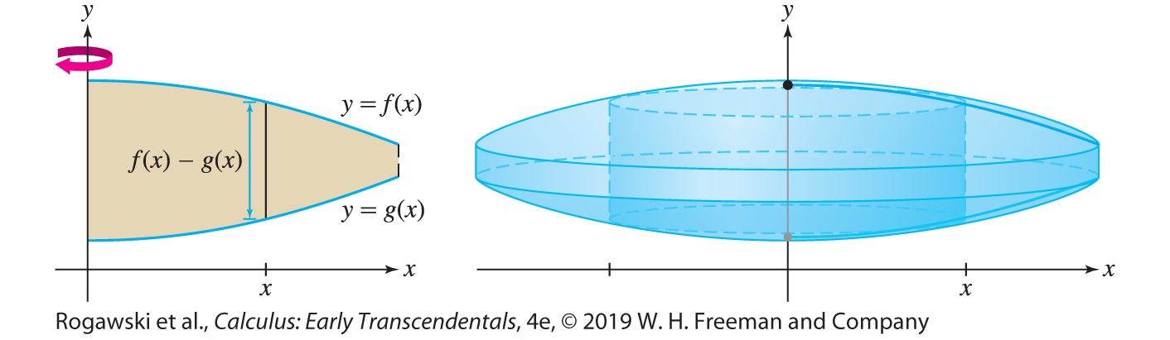

6.4 Volumes of Revolution: Cylindrical Shells (6 of 10)
When we rotate the region between the graphs of two functions f and g satisfying
f (x) ≥ g(x), the vertical segment at location x generates a cylindrical shell of radius x and height f (x) − g(x) (Figure 6). Therefore, the volume is
$$V=2π\int_{a}^{b}{\text{radiu}\text{s}∙\text{heigh}\text{t} \text{o}\text{f} \text{shel}\text{l}∙\text{d}\text{x}=2π\int_{a}^{b}{x(f\left(x\right)−g\left(x\right))}dx.}$$

Slide 62
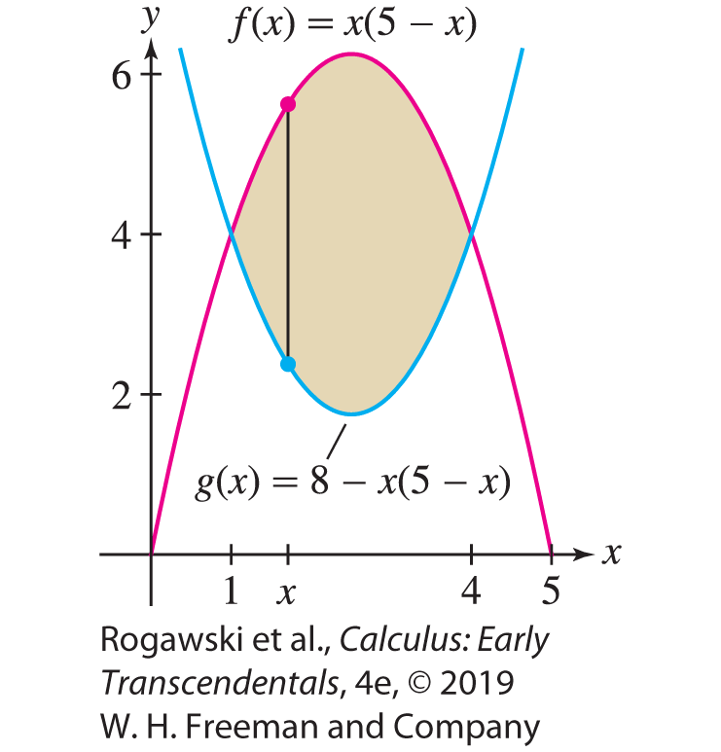

6.4 Volumes of Revolution: Cylindrical Shells (7 of 10)
EXAMPLE: Region Between Two Curves Find the volume V obtained by rotating the region enclosed by the graphs of f (x) = x (5 − x ) and g(x) = 8 − x (5 − x ) about the y-axis.
Solution First, find the points of intersection by solving x (5 − x ) = 8 − x (5 − x ). We obtain x² − 5x + 4 = (x − 1)(x − 4) = 0, so the curves intersect at x = 1, 4. Sketching the graphs (Figure 7), we see that f (x) ≥ g(x) on the interval [1, 4] and
height of shell = f (x) − g(x) = x (5 − x) − 8 − x (5 − x) = 10x – 2x² – 8
The volume is
$$V=2π\int_{1}^{4}{(10x^{2}−2x^{3}−8x)}dx$$
$$=2π\left(\frac{10}{3}x^{3}−\frac{1}{2}x^{4}−4x^{2}\right)|_{1}^{4}=45π$$

Slide 63
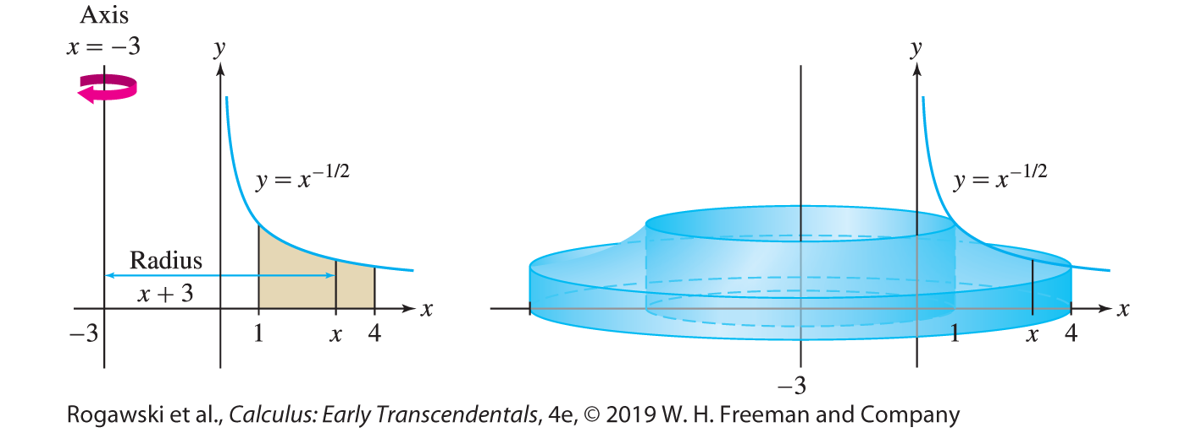

6.4 Volumes of Revolution: Cylindrical Shells (8 of 10)
EXAMPLE: Rotating About a Vertical Axis We use the Shell Method to calculate the volume V obtained by rotating the region under the graph of f (x) = x ^{−1/2} over [1, 4] about the axis x = −3. If we were rotating this region about the y-axis (i.e., x = 0), we would use Eq. (3). To rotate it around the line x = −3, we must take into account that the radius of revolution is now 3 units longer. Figure 8 shows that the radius of the shell at x is now
x − (−3) = x + 3. The height of the shell is still f (x) = x ^{−1/2}, so
$V=$ $\int_{1}^{4}{(x+3)x^{−1/2}}dx=2π\left(\frac{2}{3}x^{3/2}+6x^{1/2}\right)|_{1}^{4}=\frac{64π}{3}$

Slide 64
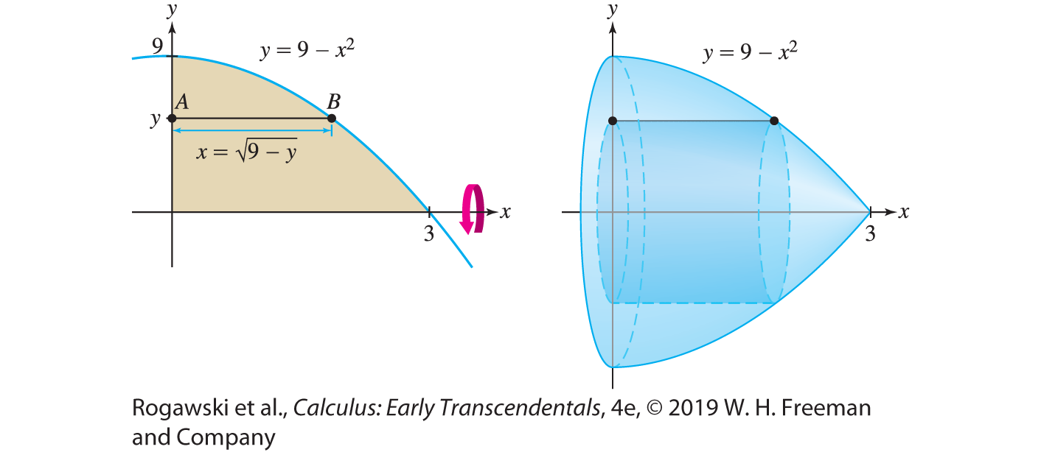

6.4 Volumes of Revolution: Cylindrical Shells (9 of 10)
EXAMPLE: Rotating About the x-Axis We use the Shell Method to compute the volume V obtained by rotating the region in the first quadrant between y = 9 − x ² and the x-axis about the x-axis. When we rotate about the x-axis, the cylindrical shells are generated by horizontal segments (AB in Figure 9) and the Shell Method gives us an integral with respect to y. The radius of the shell is y, the distance from the rotation axis to the segment. The length of AB is the height of the shell (we use the term “height” even though the shell is horizontal). The length of AB is given by the positive value of x on the parabola associated with y, that is, by $x=\sqrt{9−y}.$

Slide 65

6.4 Volumes of Revolution: Cylindrical Shells (10 of 10)
The volume is then obtained as follows, where we use a substitution u = 9 − y, du = −dy, in the integral computation:
$$V=2π\int_{0}^{9}{y\sqrt{9 −y}}dy=\int_{9}^{0}{(9−u)}\sqrt{u}du=2π\left(6u^{3/2}−\frac{2}{5}u^{5/2}\right)|_{9}^{0}=\frac{648}{5}π$$

Slide 66
6.5 Work and Energy (1 of 12)
All physical tasks, from running up a hill to turning on a computer, require an expenditure of energy. When a force is applied to an object to move it, the energy expended is called work. When a constant force F is applied to move the object a distance d in the direction of the force, the work W is defined as “force times distance” (Figure 1):
W = F∙ d
The kilogram is a unit of mass in the SI system. In the
British system, we typically work with weight,
which is a force rather than a mass. Consequently, the
factor g does not appear when work against gravity
is computed in the British system because, essentially,
this factor is incorporated in the weight. For example,
the work required to lift a 2-pound stone 3 ft is W = (2 lb)(3 ft) = 6 ft-lb.

Slide 67

6.5 Work and Energy (2 of 12)
We are interested in the case where the force F (x) varies as the object moves from a to b along the x-axis. Eq. (1) does not apply directly, but we can break up the task into a large number of smaller tasks for which Eq. (1) gives a good approximation. Divide [a, b] into N subintervals of length ∆ x = (b − a)/N as in Figure 2 and let W_{i} be the work required to move the object from x_{i −1} to x_{i} . If ∆ x is small, then the force F (x) is nearly constant on the interval [x_{i −1}, x_{i} ] with value F (x_{i} ), so W_{i} ≈ F (x_{i} ) ∆ x . Summing the contributions, we obtain $W=\sum_{i=1}^{N}{W_{i}}$.

Slide 68

6.5 Work and Energy (3 of 12)
The sum on the right is a right-endpoint approximation that converges to $\int_{a}^{b}{F(x)}dx.$
DEFINITION: Work The work performed in moving an object along the x-axis from
a to b by applying a force F (x) is
$$W=\int_{a}^{b}{F(x)}dx$$

Slide 69
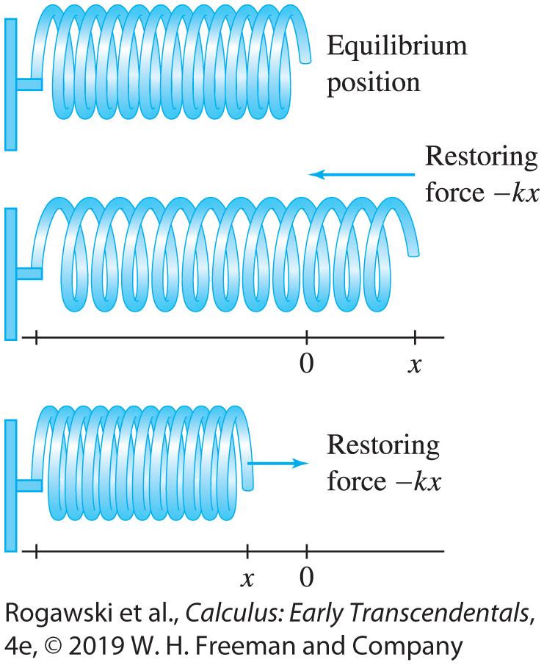
6.5 Work and Energy (4 of 12)
One typical calculation involves finding the work required to stretch or compress a spring. Assume that the free end of the spring has position x = 0 at equilibrium, when no force is acting (Figure 3). According to Hooke’s Law, when the spring is stretched or compressed to position x, it exerts a restoring spring force
F (x) = −kx , where k > 0 is the spring constant.

Slide 70

6.5 Work and Energy (5 of 12)
If we want to stretch the spring from x = a to x = b, with 0 < a < b, we must apply a force F(x) = kx to counteract the force exerted by the spring. The work required to stretch the spring is $\int_{a}^{b}{kx}dx.$
Similarly, if we wish to compress the spring from x = a to x = b with b < a, the work required is also $\int_{a}^{b}{kx}dx$. In this latter case, the integration is in the negative direction, but the force is also in the negative direction, so the result is a positive value of work.

Slide 71

6.5 Work and Energy (6 of 12)
EXAMPLE: Hooke’s Law Assuming a spring constant of k = 400 N/m, find the work required to
(a) stretch the spring 10 cm beyond equilibrium.
(b) compress the spring 2 cm more when it is already compressed 3 cm.
Solution A force F (x) = 400x N is required to stretch the spring (with x in meters). Note that centimeters must be converted to meters.
(a) The work required to stretch the spring 10 cm (0.1 m) beyond equilibrium is
$$W=\int_{0}^{0.1}{400x}dx=200x^{2}|_{0}^{0.1}=2 J$$
(b) If the spring is at position x = −3 cm, then the work W required to compress it further to x = −5 cm is $W=\int_{−0.03}^{−0.05}{400x}dx=200x^{2}|_{−0.03}^{−0.05}=0.32 J$.

Slide 72
6.5 Work and Energy (7 of 12)
In the next two examples, we are not moving a single object through a fixed distance, so we cannot apply Eq. (2). Rather, each thin layer of the object is moved through a different distance. The work performed is computed by “summing” (i.e., integrating) the work performed on the thin layers.
EXAMPLE: Building a Concrete Column Compute the work (against gravity) required to build a concrete column of height 5 m and square base of side 2 m. Assume that concrete has density 1500 kg/m³.

Slide 73
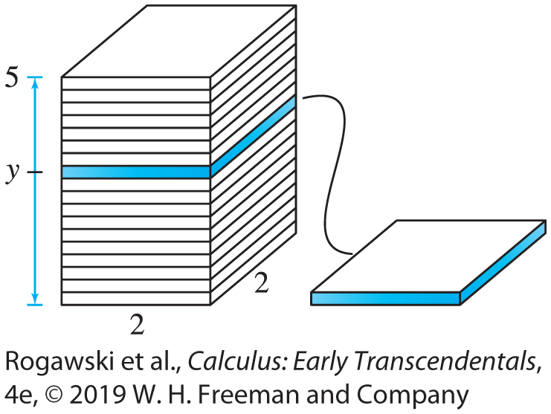
6.5 Work and Energy (8 of 12)
Solution Think of the column as a stack of n thin layers of width ∆ y = 5/n. The work consists of lifting up these layers and placing them on the stack (Figure 4), but the work performed on a given layer depends on how high we lift it. First, let us compute the gravitational force on a thin layer of width ∆ y:
volume of layer = area × width = 4 ∆ y m³
mass of layer = density × volume = 1500 · 4 ∆ y kg
force on layer = g × mass = 9.8 · 1500 · 4 ∆ y = 58,800 ∆ y N
The work performed in lifting this layer to height y is equal to the force times the distance y, which is (58,800 ∆ y)y. Setting L(y) = 58,800y, we have
work lifting layer to height y ≈ (58,800 ∆ y)y = L(y) ∆ y

Slide 74

6.5 Work and Energy (9 of 12)
This is only an approximation (although a very good one if ∆ y is small) because the layer has nonzero width and we are not taking into account that, for example, the cement particles at the top are lifted ∆ y prior to lifting the whole layer to height y. The ith layer is lifted to height y_{i}, so the total work performed is
$$W=\sum_{i=1}^{N}{L(y_{i})∆y→\int_{0}^{5}{L(y)}}dy as N →∞$$
$$W=\int_{0}^{5}{58,800y}dy=\frac{58,800}{2}y^{2}|_{0}^{5}=735,000 J$$

Slide 75
6.5 Work and Energy (10 of 12)
EXAMPLE: Pumping Water out of a Tank A spherical tank of radius 5 m is filled with water. Calculate the work W performed (against gravity) in pumping out the water through a spout of height 1 m at the top. The density of water is 1000 kg/m.
Solution The first step, as in the previous example, is to compute the work against gravity performed on a thin layer of water of width ∆ y. We place the origin of our coordinate system at the center of the sphere because this leads to a simple formula for the radius r of the cross section at height y (Figure 5).

Slide 76

6.5 Work and Energy (11 of 12)
Step 1. Compute work performed on a layer.
Figure 5 shows that the cross section at height y is a circle of radius $r=\sqrt{25−y^{2}}$ and area A(y) = πr ² = π (25 − y²). A thin layer has volume A(y)∆ y and mass obtained by multiplying this volume by the density 1000 kg/m³. To lift this layer, we must exert a force against gravity equal to
force on layer = g × density × A( y )∆ y ≈ (9.8)1000π (25 − y²)∆ y
The layer has to be lifted a vertical distance 6 − y, so
work on layer ≈ 9800π (25 − y²)∆ y × (6 − y) = L(y)∆ y
where L(y) = 9800π (25 − y²)(6 − y) = 9800π (150 − 25y − 6y² + y³).

Slide 77

6.5 Work and Energy (12 of 12)
Step 2. Compute total work.
Now, divide the sphere into N layers and let y_{i} be the height of the ith layer. The work performed on ith layer is about L(y_{i} ) ∆ y. Thus, $W=\sum_{i=1}^{N}{L(y_{i})∆y}$. Since this sum approaches the integral of L(y) as N →∞ (i.e., ∆ y → 0),
$$W=\int_{−5}^{5}{L(y)}dy=\int_{−5}^{5}{\text{9800}\text{π} \text{(15}\text{0} \text{−} \text{2}\text{5}\text{y} \text{−} \text{6}\text{y}\text{2} \text{+} \text{y}\text{3}\text{)}}dy$$
$$=9800π\left(150y−\frac{25}{2}y^{2}−2y^{3}+\frac{1}{4}y^{4}\right)|_{−5}^{5}=3.1∙{10}^{7} J$$
Note that the integral extends from −5 to 5 because the y-coordinate along the sphere varies from −5 to 5.
How much energy is 3.1 ∙ 10⁷ J? A liter of gasoline contains approximately 3.4 ∙ 10⁷ J of energy. Hence, the work required to pump the water out of the spout is equal to the energy content of roughly 0.9 L of gasoline.

